Slide 1
Modeling of high-strength steels (HSS) in automobile forming (DP1000)
Group 5: An Mai, Thoa Le, Hoang Le, Linh Nguyen
Advisor: Li Zinan
Supervisor: Junhe Lian
Aalto University, Finland
Notes:
high strength and hierarchical bcc microstructure

Slide 2
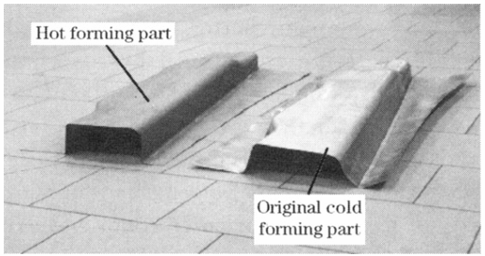
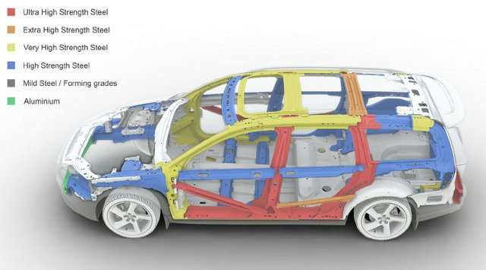
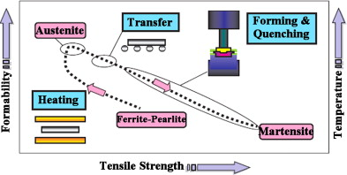
Introduction
Picture of hot forming and cold forming vehicle parts. Chang, Meng, et al, 2011
* Advanced steel applications in a modern car body structure. Asghari et al, MSEA 2013.
An overview of the hot stamping process sequence. Naderi et al, 2011

Slide 3
Table of Contents
Introduction
Methodology:
Uniaxial Tensile Tests
Machine Learning
Flow Fitting Curve
Abaqus Simulation
Fracture Tests – Force Displacement curves
Strain-Rate & Temperature dependency parameter calibration
Current Progress:
Constitutive Model
Machine Learning
Discussion and Conclusion:
Provide a future timeline
Discussion

Slide 4
Table of Contents
Introduction Motivation --An
Methodology --An
Brief recap of working flow
Recap first half progress: Constitutive + ML
Constitutive model
Temperature calibration: How + results --Thoa
Strain-rate calibration: How + result --Linh
Validation --An
Machine learning --Hoang
How + results
Validation: 500C with simulation
Discussion + Conclusion
Summary of final results + compare with the existing paper -- Thoa
Limitations + future improvement -- Linh
Conclusion: Lesson learnt

Slide 5
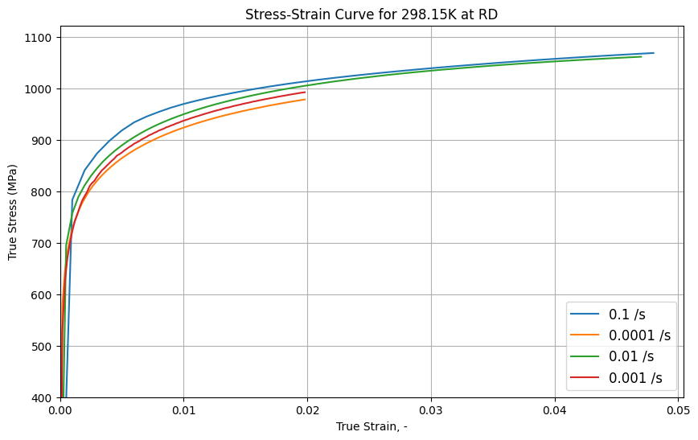
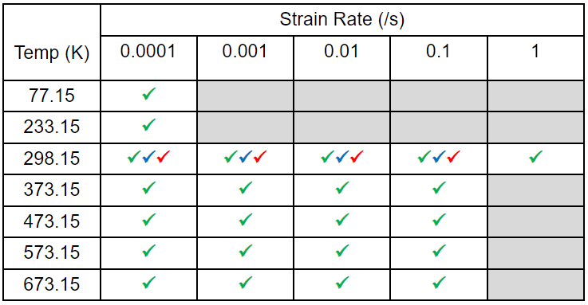
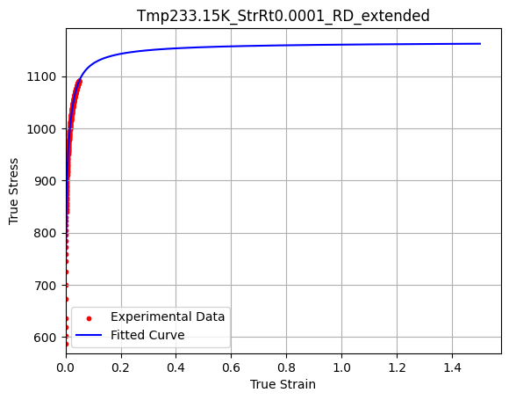
Methodology
1. Uniaxial tensile tests 43 cases on DP1000 (DD,RD,TD,Tmpt, StrnRt)
3. Flow fitting curve
MACHINE LEARNING
MACHINE LEARNING
1. Uniaxial tensile tests
LSTM model
1. Uniaxial tensile tests
LSTM model
CONSTITUTIVE
MODEL
Swift-Voce law
CONSTITUTIVE
MODEL
Swift-Voce law
3. Flow fitting curve
2. Flow fitting curve
2. ML-coupled for temperature and strain-rate dependence
9. ML-coupled for temperature and strain-rate dependency
DP1000 properties
Loading direction
VUMAT subroutine
4. Abaqus simulation
3. Abaqus simulation
6. Strain-Rate & Temperature dependent parameter calibration
NO YES
6. Strain-Rate & Temperature dependency parameter calibration
Thermal softening and dynamic strain aging model
Evolving
Non-Associated
Hill48
xxx
8. Fracture parameter calibration
5. Fracture tests

Slide 6
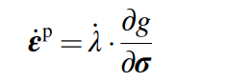
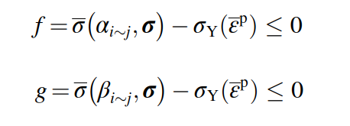
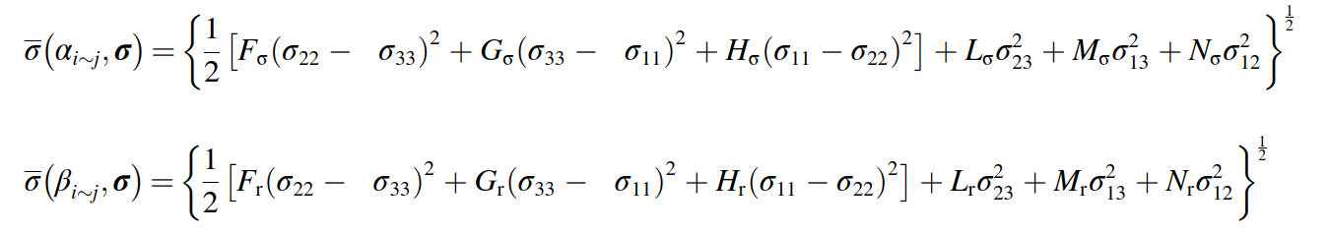
Methodology
4. Abaqus simulation - Evolving Non-Associated Hill48 Model
MACHINE LEARNING
 | Associated Flow Rule | Non-Associated Flow
Yield & Potential Function | Identical | Distinct
Plastic Flow Direction | Aligned with yield surface | Can differ from yield surface
Complexity | Simpler, less flexible | More complex, more flexible
Material Behavior | isotropic materials | anisotropic materials
Applications | Basic applications | Advanced modeling and simulations
1. Uniaxial tensile tests
LSTM model
Swift-Voce law
3. Flow fitting curve
2. ML-coupled for temperature and strain-rate dependence
4. Abaqus simulation
6. Strain-Rate & Temperature dependent parameter calibration
Flow rule
Yield function
Flow potential
Notes:
where σ is the equivalent stress with αiej and βiej as anisotropic parameters that correlate the response of the material under arbitrary loading conditions defined by the stress tensor σ with the reference stress state σYðεpÞ. λ_ is a scalar factor with non-negative values used
for updating the plastic strain rate tensor ε_p. where Fσ, Gσ, Hσ, Lσ, Mσ and Nσ correspond to anisotropic parameters (α1e6) in the yield function while Fr, Gr, Hr, Lr, Mr and Nr represent anisotropic parameters (β1e6) in the flow potential, which are calibrated independently using experimental results obtained from uniaxial and biaxial tensile tests. The calibration of these parameters for the yield function and flow potential (L ¼M ¼3 for the plane stress condition) is given in the following equations.

Slide 7
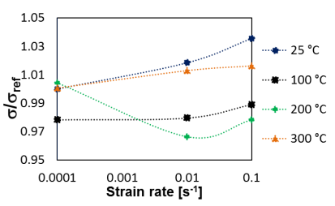
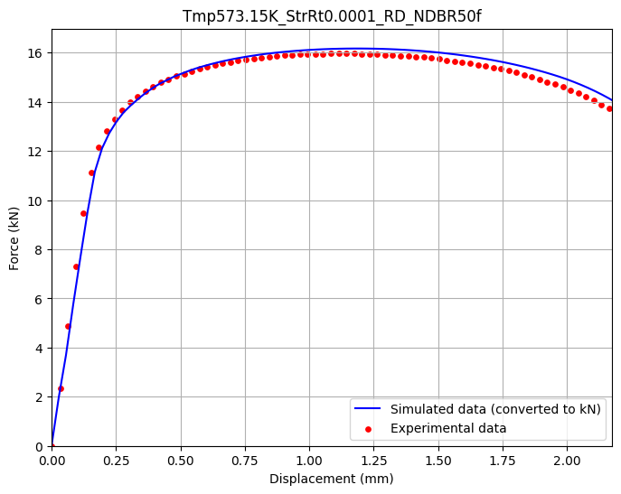
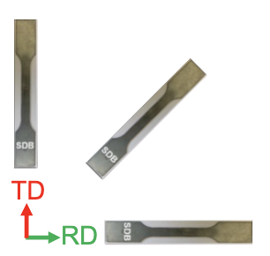
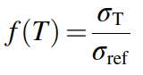
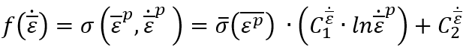
Methodology
4. Abaqus simulation
DP material properties including strain, stress in RD,TD,DD, biaxial direction, r-values (Lankford coefficients).
Loading direction for 5 geometries
VUMAT subroutine
5. Fracture tests – Force and Displacement curve
MACHINE LEARNING
1. Uniaxial tensile tests
LSTM model
Reference
CONSTITUTIVE
MODEL
Swift-Voce law
3. Flow fitting curve
2. ML-coupled for temperature and strain-rate dependence
DP1000 properties
Loading direction
VUMAT subroutine
4. Abaqus simulation
NO
6. Strain-Rate & Temperature dependent parameter calibration
YES
6. Temperature & Strain-rate dependent parameter calibration
Thermal softening and dynamic strain aging model
Reference
Evolving
Non-Associated
Hill48
thermal softening Dynamic Strain Aging
5. Fracture tests
Tasks:
C1 and C2: thermal activation components
C3: athermal contribution
C4,C6: intensity of the DSA
C5: temperature characteristics where the DSA effect peaks.
Evolving with strain
Calibrated at different strain rate

Slide 8
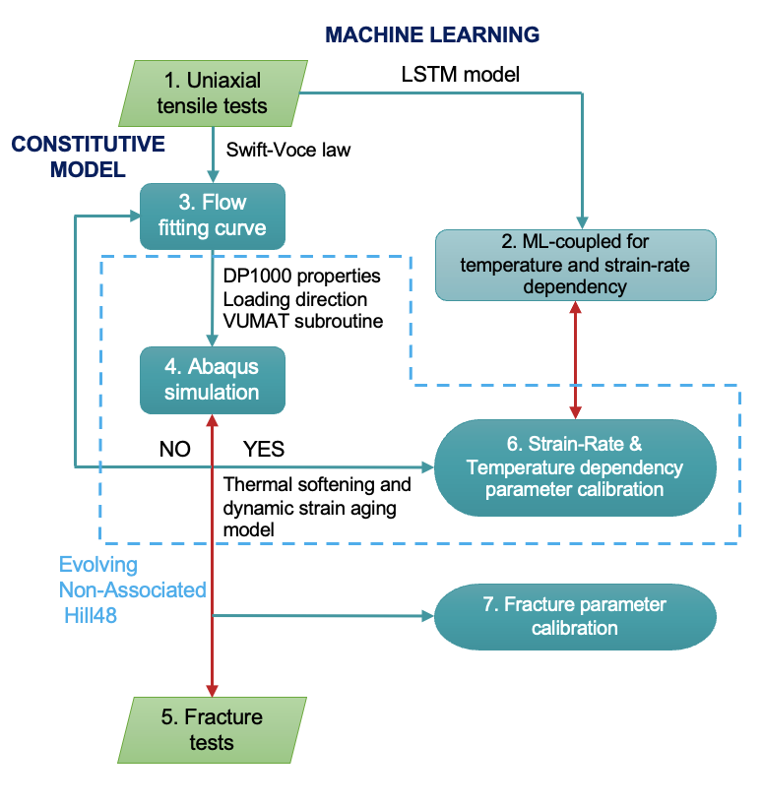
CURRENT PROGRESS: Constitutive model
What has been done?
Read research papers and understand enHill48 and MBW model
Process experimental data
Curve fitting in Python for flow curve and r-value from experimental data
Validate flow curve with force-displacement curve by running simulation (in progress)
What need to be done?
Continue running simulation for failed conditions
Fine tune flow curves where force-displacement data is incorrect
Calibrate parameters for temperature-dependent and strain rate-dependent

Slide 9
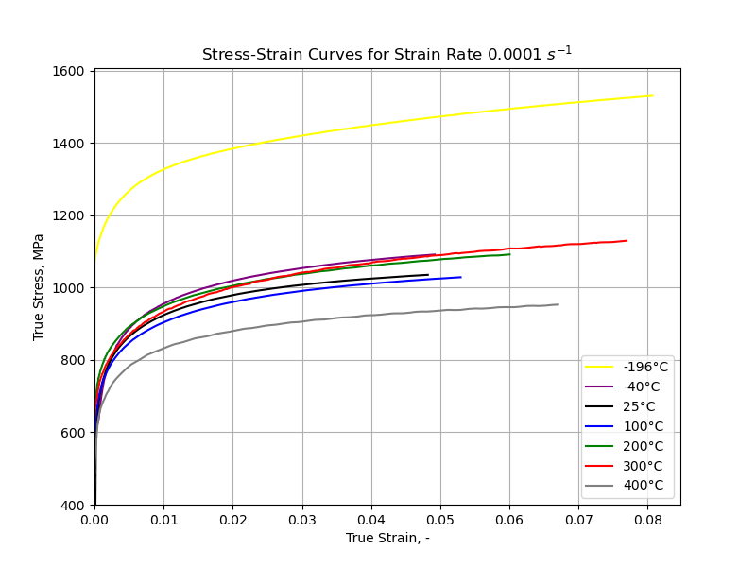
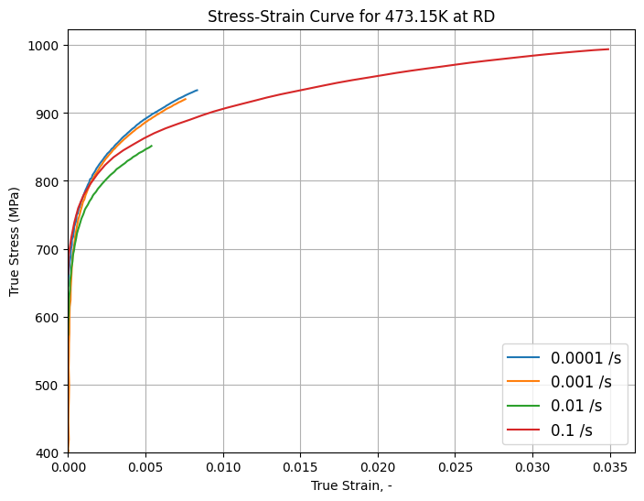
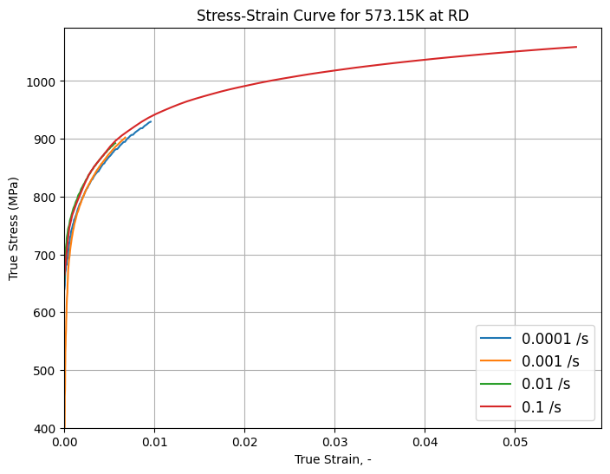
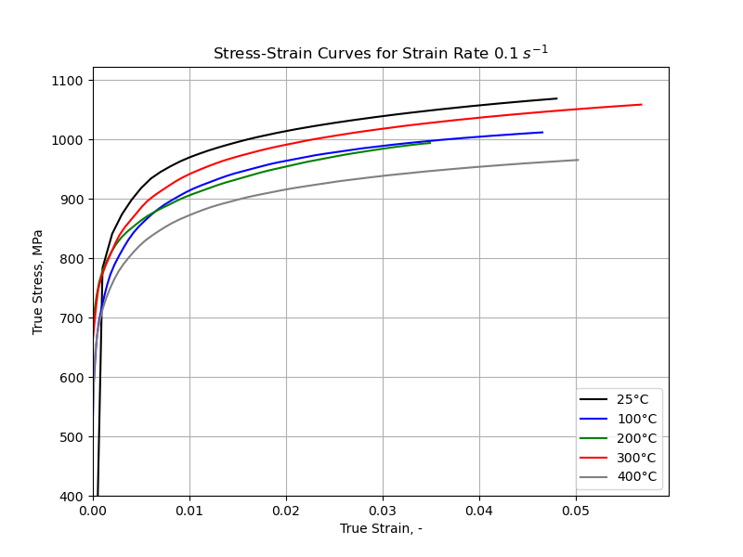
Flow curves from experiment data
An overview of how material behave under different conditions.
Dynamic Strain Aging (DSA): At 300°C, flow curves show the high stress even at high strain rates. It is possible material is experiencing DSA.
Low temperature: The -196°C curve shows much higher stress values than the other temperatures, reflecting resistance to deformation

Slide 10
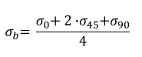
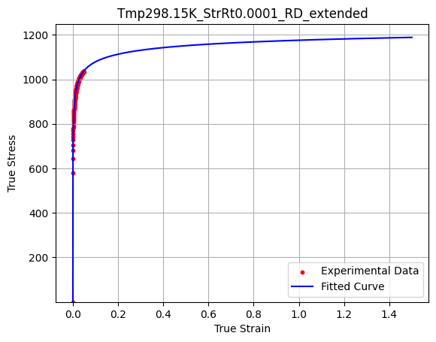
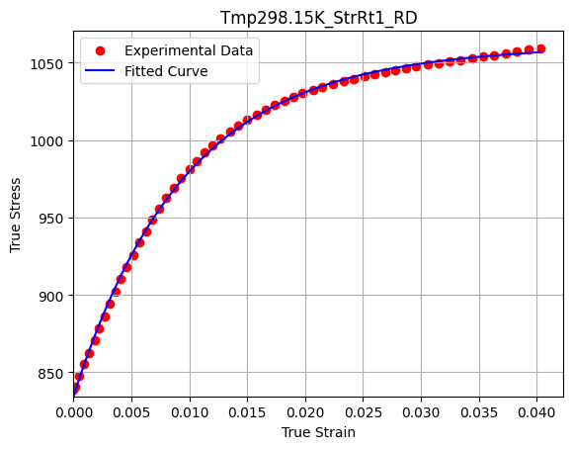
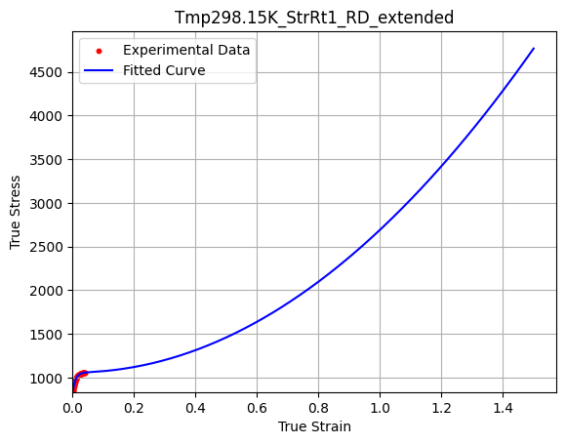
Curve fitting strategy and results
Flow curve fitting
Problem: Experimental data is limited, only available for strain value < 0.1.
For each condition, use curve_fit function from scipy.optimize to find parameters for Swift-Voce equation if low strain rate and modified Swift-Voce equation if high strain rate.
Notes:
SV equation models typical strain hardening, which is dominant at slower deformation speeds. MSV equation includes terms that account for additional hardening mechanisms or dynamic effects that become significant at higher speeds.

Slide 11
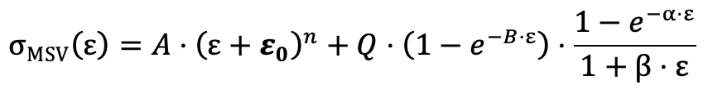
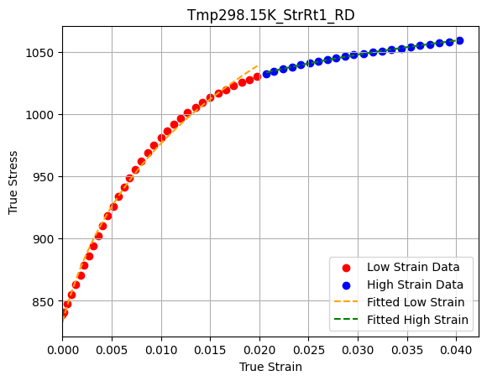
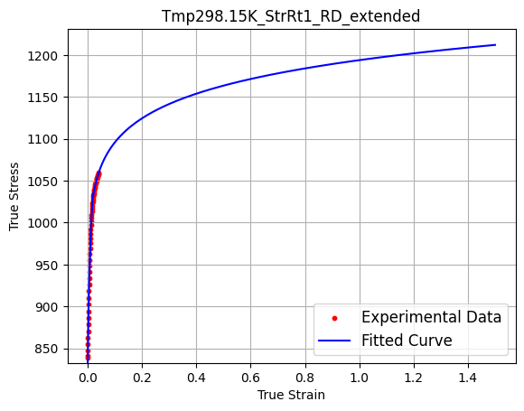
Curve fitting strategy and results
Flow curve fitting
Problem: Experimental data is limited, only available for strain value < 0.1.
For each condition, use curve_fit function from scipy.optimize to find parameters for Swift-Voce equation if low strain rate and modified Swift-Voce equation if high strain rate.
Notes:
SV equation models typical strain hardening, which is dominant at slower deformation speeds. MSV equation includes terms that account for additional hardening mechanisms or dynamic effects that become significant at higher speeds.

Slide 12
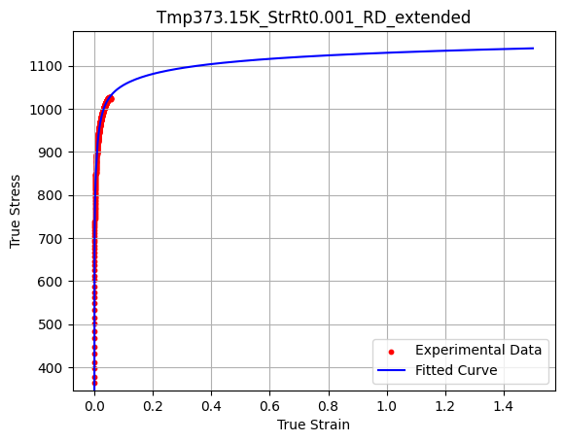
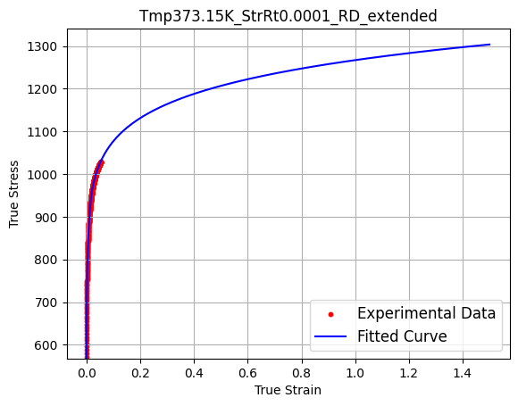
Curve fitting strategy and results
Flow curve fitting
Problem: Experimental data is limited, only available for strain value < 0.1.
For each condition, use curve_fit function from scipy.optimize to find parameters for Swift-Voce equation if low strain rate and modified Swift-Voce equation if high strain rate.
Notes:
SV equation models typical strain hardening, which is dominant at slower deformation speeds. MSV equation includes terms that account for additional hardening mechanisms or dynamic effects that become significant at higher speeds.

Slide 13
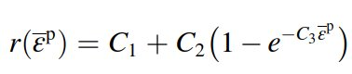
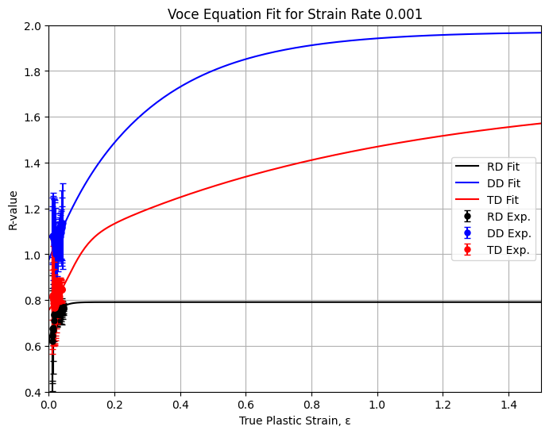
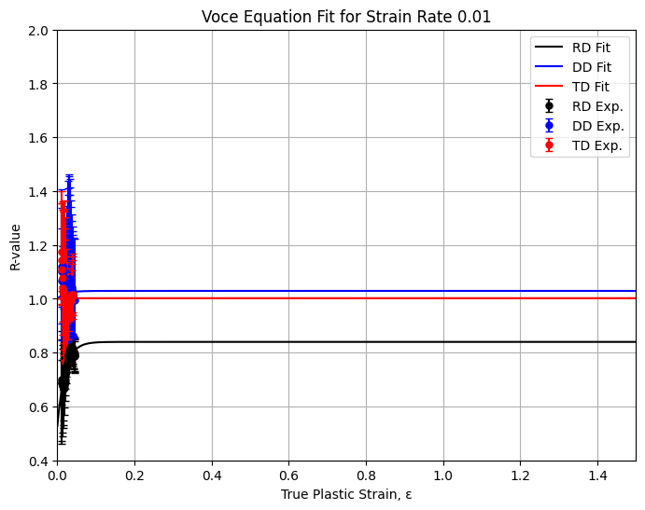
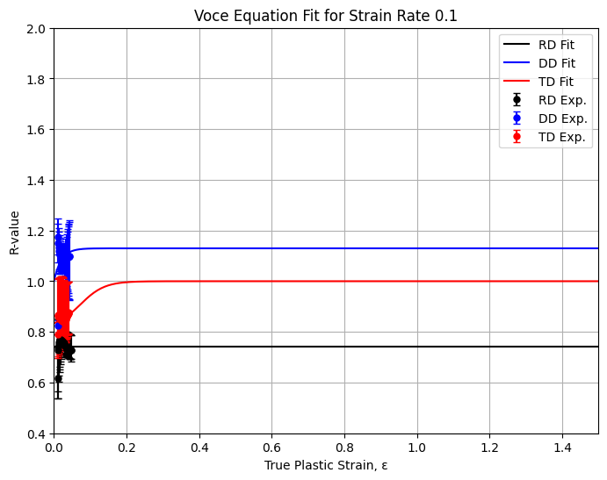
Curve fitting strategy and results
r-value fitting
Problem: Experimental data is limited, only available for strain value < 0.1.
Generate more data (strain up to 3) to have r-value to run simulation.
For each condition, use curve_fit function from scipy.optimize to find parameters for residual function.
Notes:
Incorporates a logistic function and weighting terms that enable gradual convergence of r-value toward 1, providing more realistic and stable predictions.

Slide 14
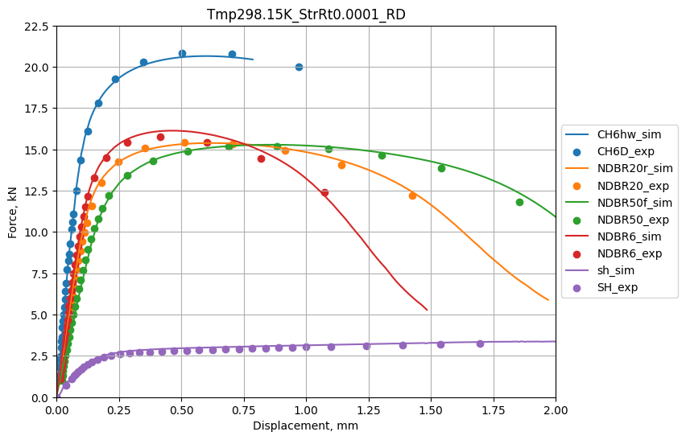
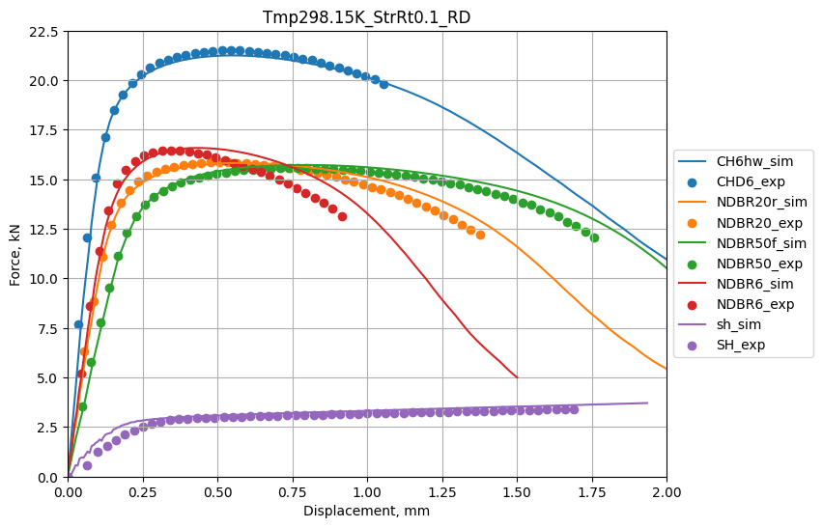
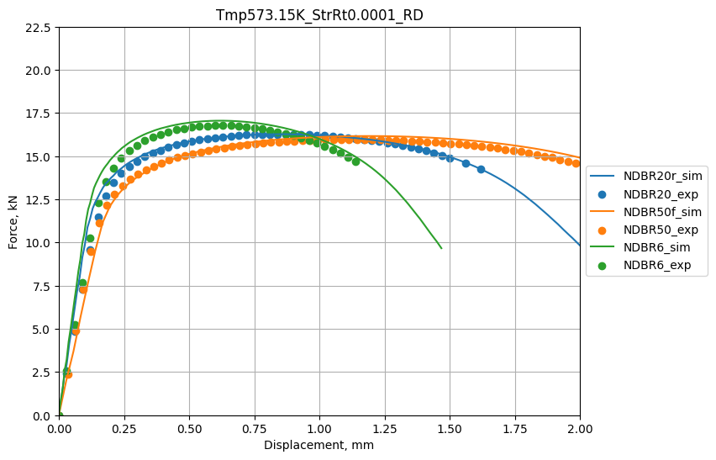
Flow curve validation with force-displacement and simulation
Validation result
Simulation running with CSC: In total, we have run 305 simulation cases, 60% successful.
Export ODB file to Abaqus and run visualization.
Comparing simulated force-displacement curve and experimental data gives good results for RT, 373.15K and 473.15K.
Main difficulty: Long simulation running time, FEM model mesh distortion, run out of tokens.

Slide 15
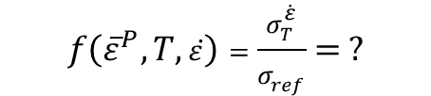
Current Progress: Machine Learning – coupled for temperature and strain rate dependency
We have done ...
V1
Temperature
V2
Strain rate
Visualize flow curves from experiments.
Preprocess and organize experimental flow data into sequences for input into an LSTM.
Build and run the LSTM model for our experimental data.
$$f\left({\overline{ε}}^{P}, T,\dot{ε}\right)=\frac{σ_{T}^{\dot{ε}}}{σ_{ref}}= ?$$
We determine to ...
X
plastic strain
Y
Normalized stress
Optimize the accuracy of the LSTM model for a better prediction of material behaviors (hyperparameters tuning, overfitting prevention, etc.)
Comparative analysis with strain rate and temperature dependent functions calibration.

Slide 16
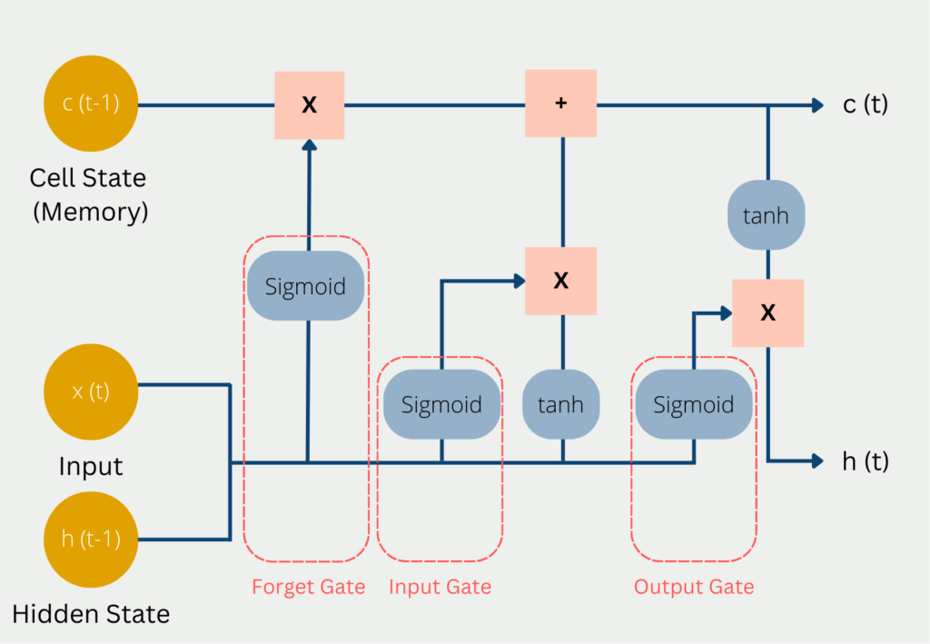
Long Short-Term Memory (LSTM)
Motivation
Traditional recurrent neural networks struggle with long-term dependencies due to vanishing gradients. LSTM has a unique architecture that retains information over long periods.
Each LSTM unit (neuron) includes 3 gates:
Forget Gate: Decides information to discard from the cell state.
Input Gate: Determines new information to store in the cell state.
Output Gate: Controls the output based on the cell state.
→ LSTM is useful for sequential data.
LSTM Architecture

Slide 17
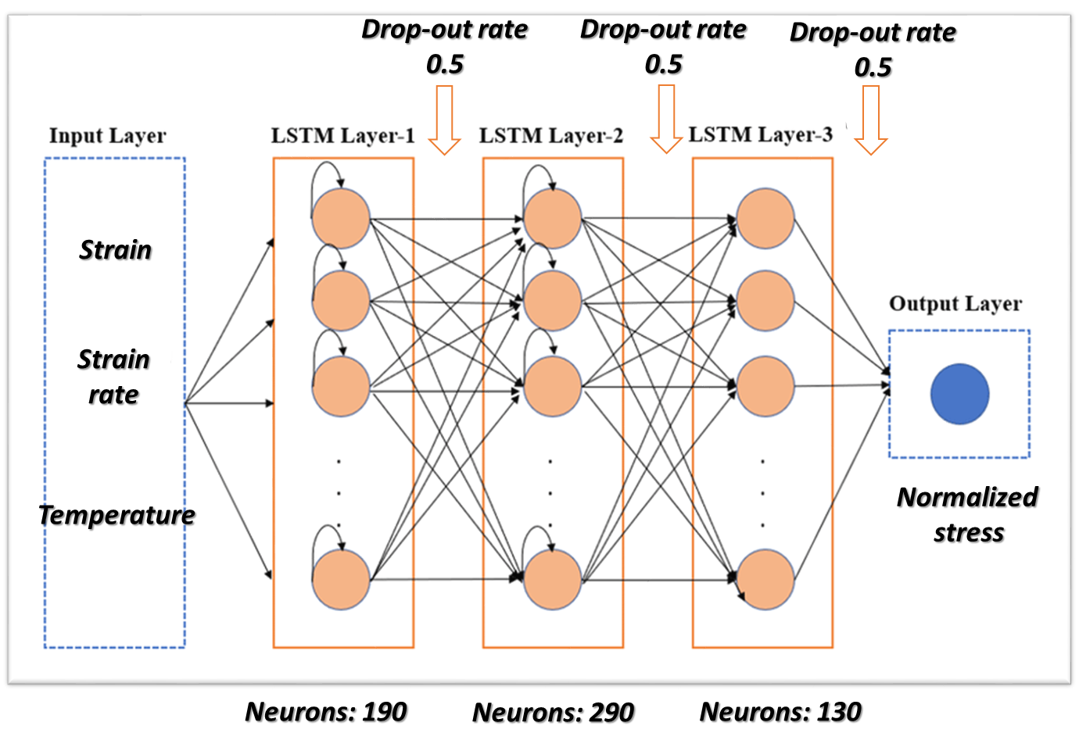

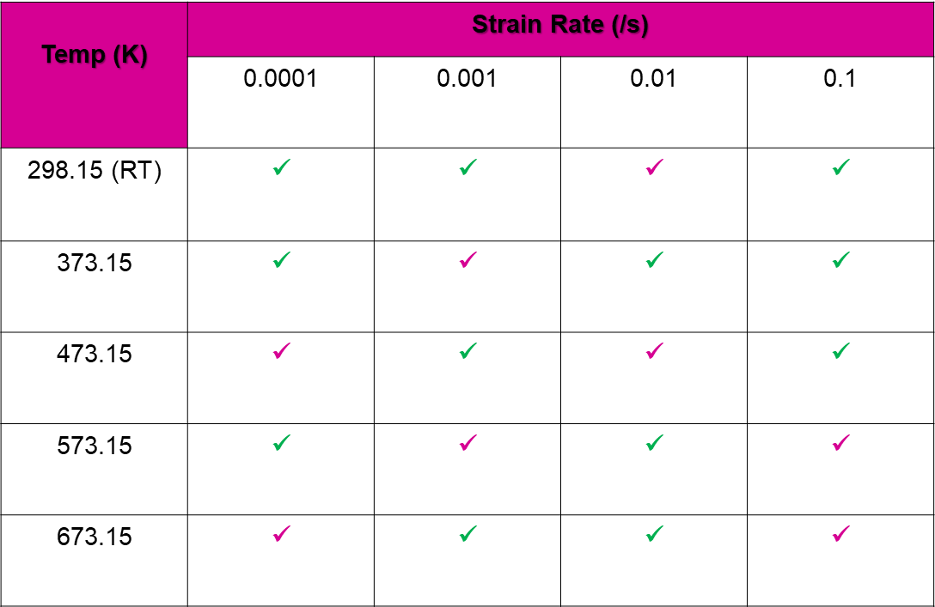
LSTM Architecture in our study
Flow curves must represent all conditions.
After many trials
→ 8 flow curves for training
+ 12 flow curves for testing
Hyperparameter tuning: RandomizedSearchCV
Epochs: 75 Batch: 64
Loss function: Mean squared error (MSE)

Slide 18
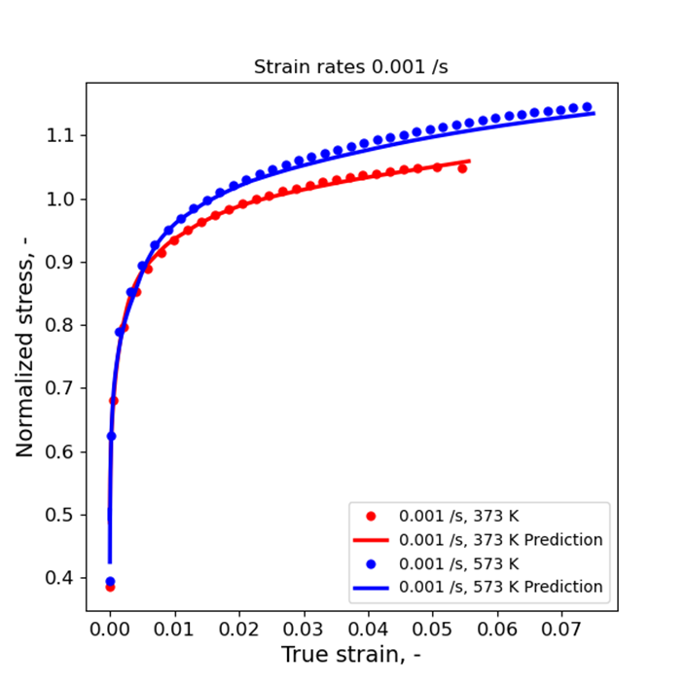
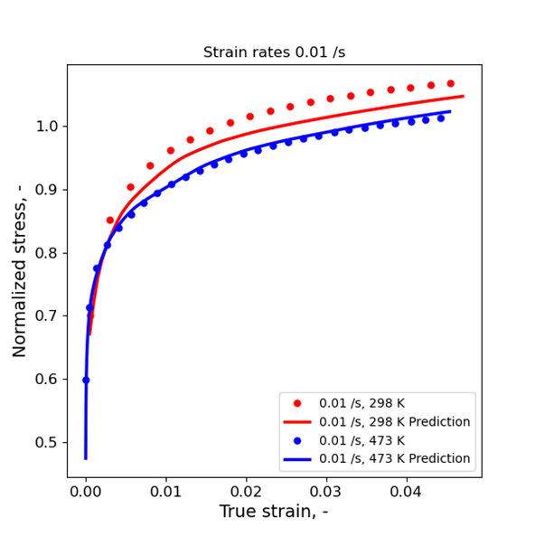
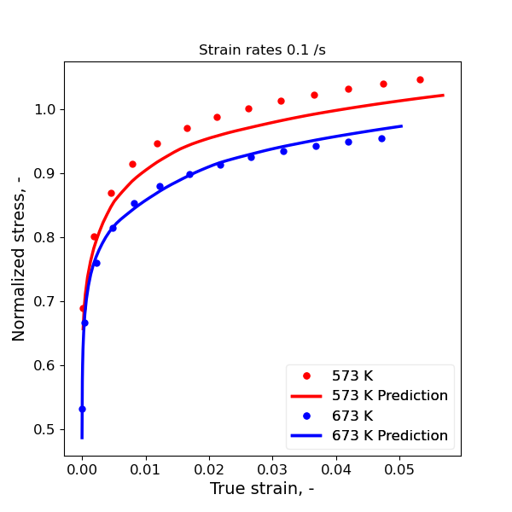
Training results
r2-score > 0.985

Slide 19
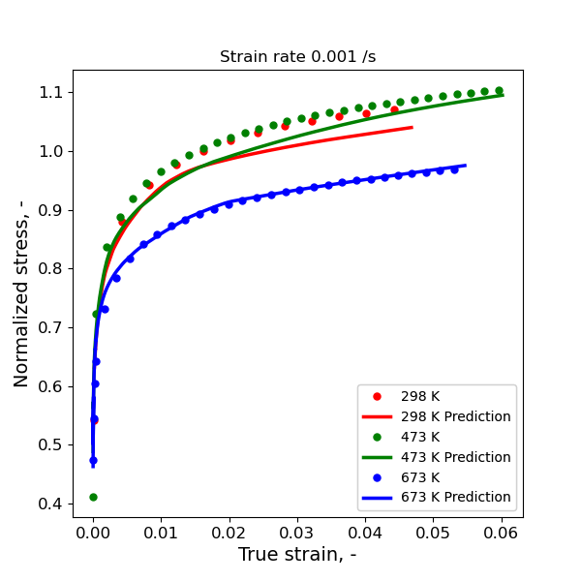
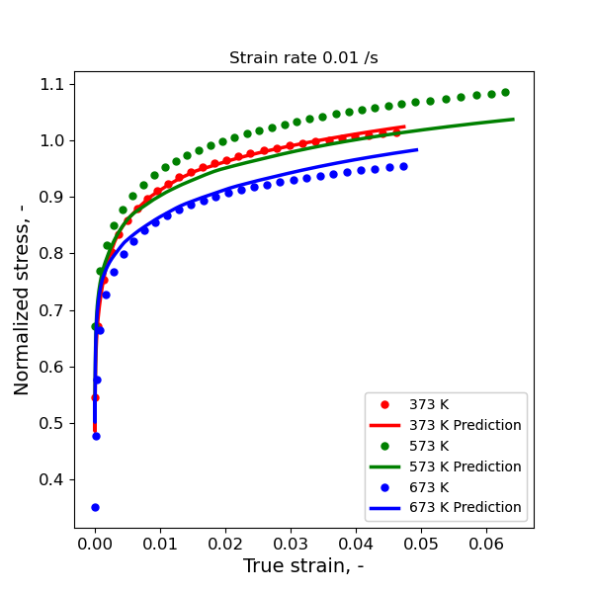
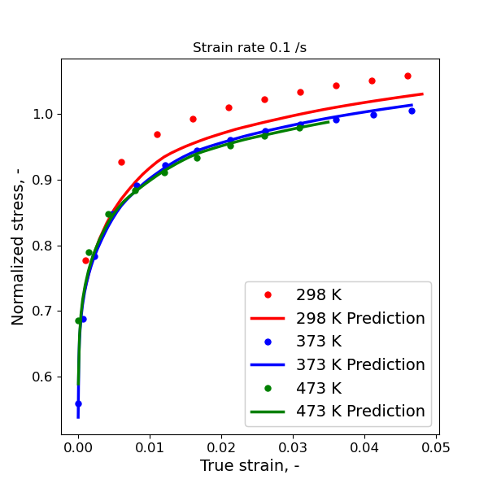
Testing results
Not good performance on unseen data
Several flow curves deviate from actual data

Slide 20
Future Timeline
Week 8
Week 9
Week 10
Week 11
Week 12
Week 13
Week 14
LSTM Optimization
Continue Simulation + Model Optimization
Parameters Calibration (Tmp_Dpn, StrRt_Dpn, Fracture)
Write Report
Second Draft
Presentation
Results Refinement

